Slide 1


Team 38: Virtual Try-On Clothing
Bi-Weekly Update 1 Robin Martinez, Alan Vela, Jorge Olivares Sponsor: Pranav Dhulipala TA: Fardeen Mozumder
Notes:
Michelle

Slide 2
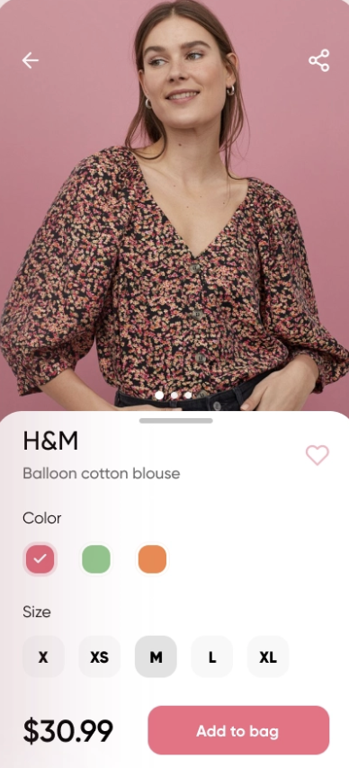
Project Summary
Waste material reduction for companies producing apparel.
Our application is going to be an accessible tool for consumers shopping online for clothing. This tool will create an avatar based on the video provided and it will be able to change between clothes.

Slide 3
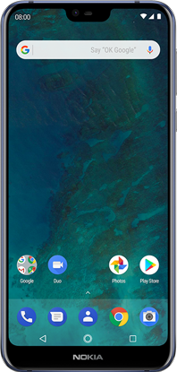
Subsystem Overview
GUI Application:
Displays the user with the application
Uploads and receives user information to a database
Database:
Stores the user’s information together with their avatar
Supply different options offered for the avatar to change clothes
Neural Network:
Receives a .mp4 video from the database
Returns a clothed 3D model of the user in .obj format
Robin | Alan | Jorge
Neural Network
GUI
App
Design
Shape Representation
Convolutional Architecture
Clothing Database
Loss Function
Optimization

Slide 4
Major Changes from 403 to 404
Challenge
Our renderer, DIRT, was not compatible with newer versions of CUDA
After downgrading to older versions of CUDA, still ran into issues with compatibility
Solution
Switching from RHEL to Ubuntu operating system
Ubuntu is more popular than RHEL, better support from developers

Slide 5
Project Timeline
08/31 | 09/14 | 09/28 | 10/12 | 10/26 | 11/16
Setting up Olympus server | ML algorithm set up and ready to work on server | ML algorithm training the model | ML algorithm training the model | Implement ML model into application | Testing application with ML model and bug fixing.
Verify GUI and database are working | GUI able to write on database | GUI properly communicating with the database | Testing application on phone and bug fixing | Implement ML model into application | Testing application with ML model and bug fixing.

Slide 6
GUI Application
Accomplishments since 403 4 hrs | Ongoing progress/problems and plans until the next presentation
Able to compute a “working” application Able to test application on phone | Change dependencies/code to establish a connection to database Create clothing to be displayed on app catalog

Slide 7
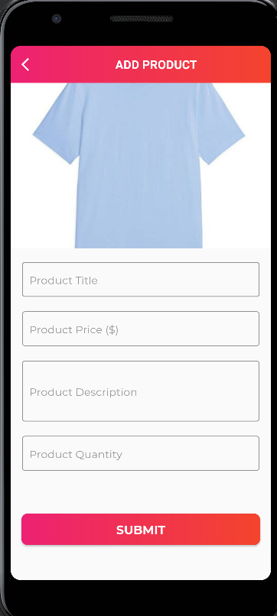
GUI Application
What works
- User Login/Register
- Item selection (locally) and shopping cart storing
- Setup upload video
What doesn’t work
- Clothing displayed on app catalog
- Application not working on physical
phone giving errors
- Integration to store clothing/video/login information
to database

Slide 8
Machine Learning Model
Accomplishments since 403 8 hrs | Ongoing progress/problems and plans until the next presentation
N/A | Switching over to Ubuntu OS from RHEL OS Smoothing out some issues with the Semantic Segmentation code

Slide 9
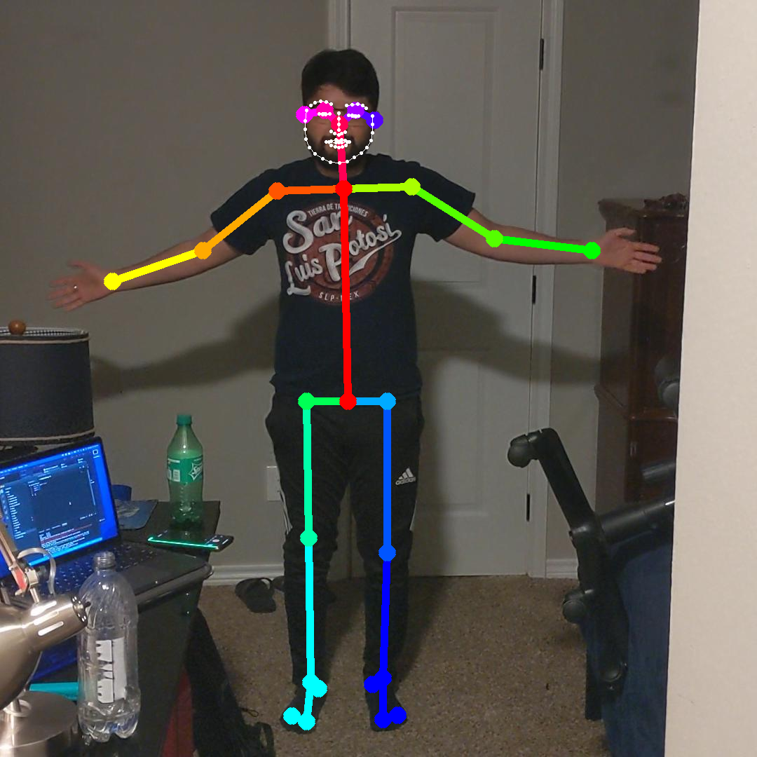
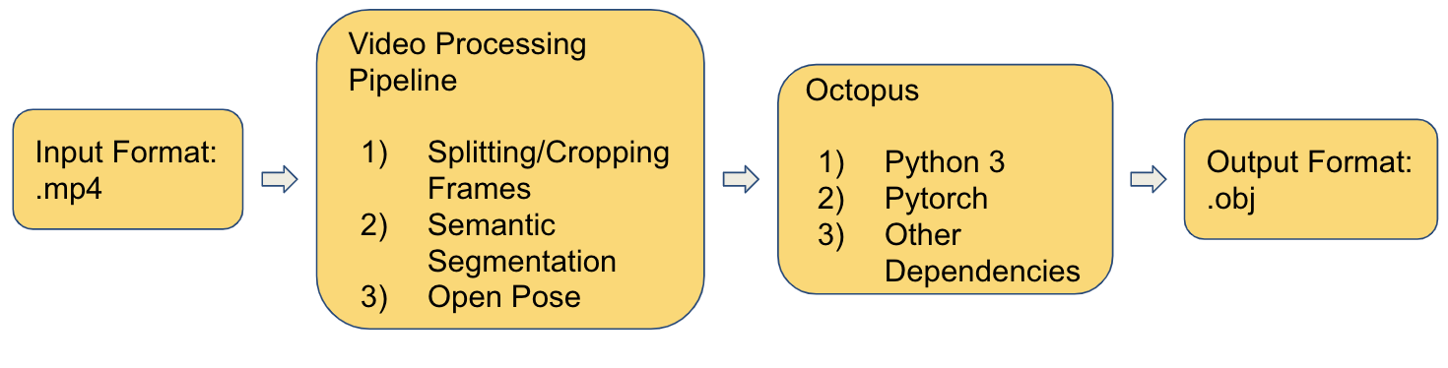
Machine Learning Model
What works
Video preparation into OP and SS
Open Pose output
What doesn’t work
Semantic Segmentation (coding errors)
ML algorithm on Server (OS errors)

Slide 10
Cloud Database
Accomplishments since 403 3 hrs | Ongoing progress/problems and plans until the next presentation
Verify the database is storing data on the cloud. Test data write and read to the database. | Establish a connection between the GUI and database. Have the GUI writing to the database.

Slide 11
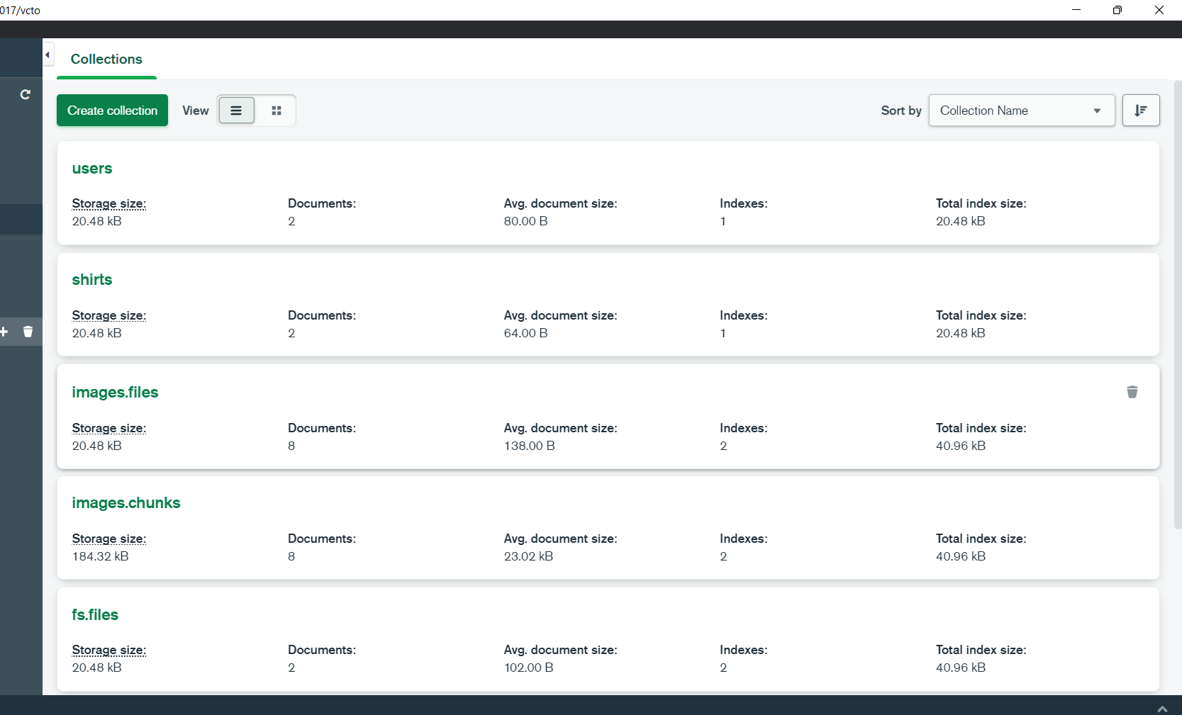
Cloud Database
What works
User password storage and verification
Storage of image files and 3D objects
User’s avatar is store independently
What doesn’t work
Database security
Clothing catalog available
Currently not working with the GUI application

Slide 12
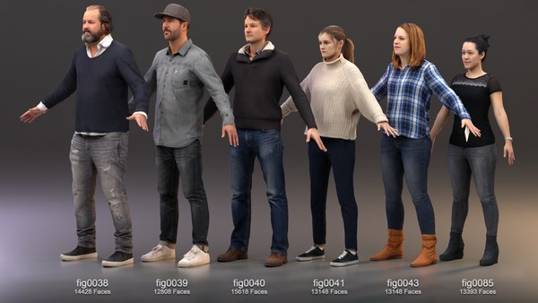
Part Ordering Status
People Posing Dataset
To be purchased from renderpeople.com, axyzdesign.com, and Twindom
Remains to be ordered
Android Phone
To be ordered from the ECEN department

Slide 13
Execution Plan
 | 09/05 | 09/12 | 09/19 | 09/26 | 10/3 | 10/10 | 10/17 | 10/24 | 10/31 | 11/7
Setting access and connection to Olympus
Prepare budget and approve for parts
Get the GUI writing on database
Set up model on Olympus
Purchase Posing Database
GUI reading information from database
Train Model
Create a catalog for the avatar
Display clothing catalog and dummy model
Test app on phone and bug fix
Create app package with ML model
Test app on phone with ML model and bug fix
Completed | In-progress | Not Started

Slide 14
Validation Plan
Test Name | Criteria | Owner | Status
Server ready for the ML algorithm | Access granted and connection established with the server | Robin | Untested
GUI writing to the database | User information stored in the database | Jorge,Alan | Untested
ML algorithm ready for training | Test machine learning algorithm to see the proper file is delivered (.obj) | Robin | Untested
GUI reading and displaying information | Retrieval of clothing options to the GUI and displaying a catalog | Jorge,Alan | Untested
Test app without model integration | Run the application on an actual phone and test it for possible bugs. | Jorge,Alan | Untested
Train the model | Run the machine learning algorithm through Pytorch and check outputs to view progress | Robin | Untested
Deploy trained model into application | Test the model receiving input from the application and change clothes | Group | Untested
Test application with model integration on phone | Run the application on actual phone with video input and test for possible bugs | Group | Untested

Slide 15
Questions?

